Slide 1

SELF CARE
WHAT TO DO TO TAKE CARE OF YOURSELF IN TIMES OF STRESS

Slide 2

STAY ORGANIZED
Make lists
Make your own due dates before the actual due dates
Keep a calendar/schedule

Slide 3
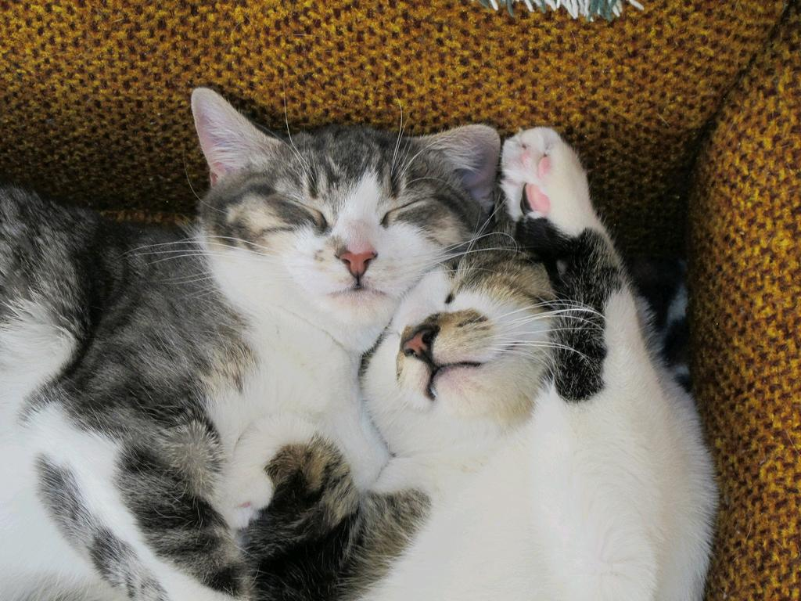
GET ENOUGH SLEEP
The average person needs 6-8 hours
Keep a regular sleep routine (even on weekends)
Avoid caffeine, alcohol, nicotine and electronics before bed
cc: tsakshaug - https://www.flickr.com/photos/75389315@N00

Slide 4
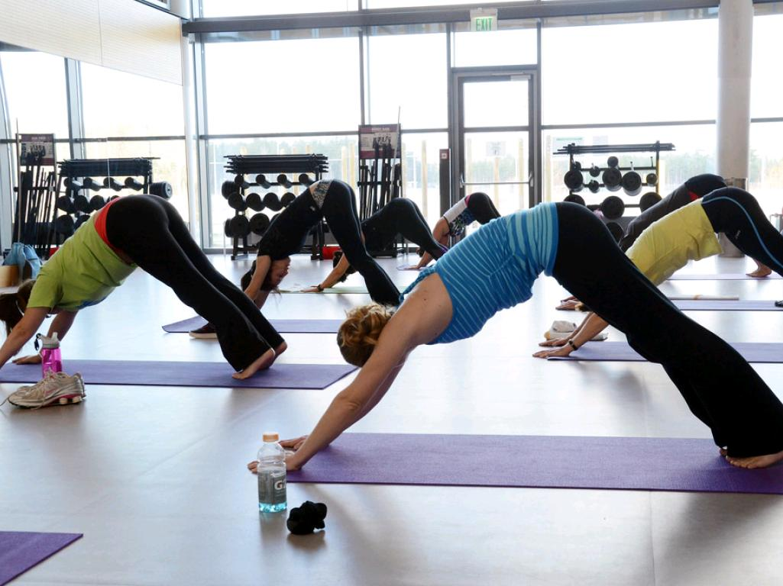
TRY A YOGA CLASS
FREE AT UREC FIT!
cc: Army Medicine - https://www.flickr.com/photos/39582141@N06

Slide 5
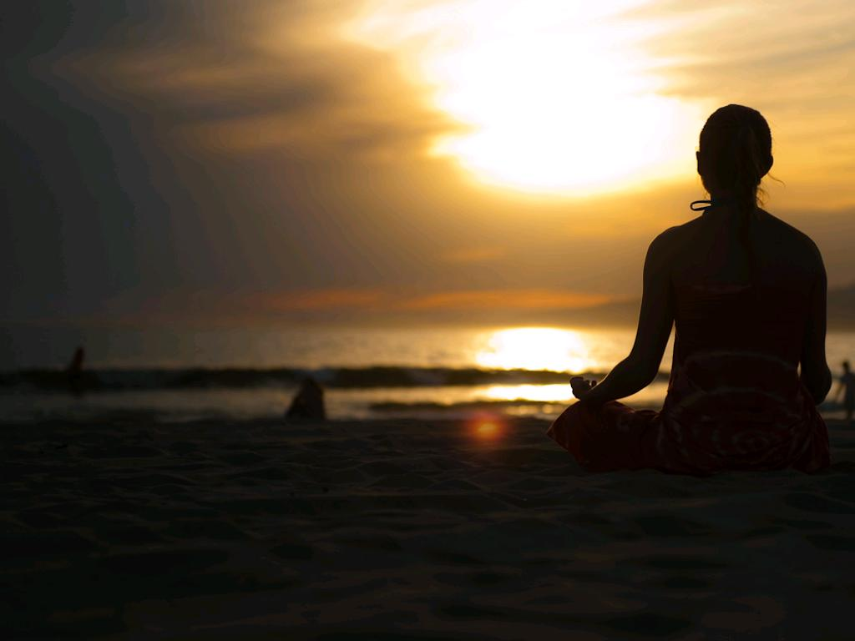
Try group meditation or find a space of your own
Follow this 10-step guide (http://stopandbreathe.com/2011/03/04/meditation-101-a-10-step-beginners-guide/)
cc: fabionascimento - https://www.flickr.com/photos/98721888@N00

Slide 6
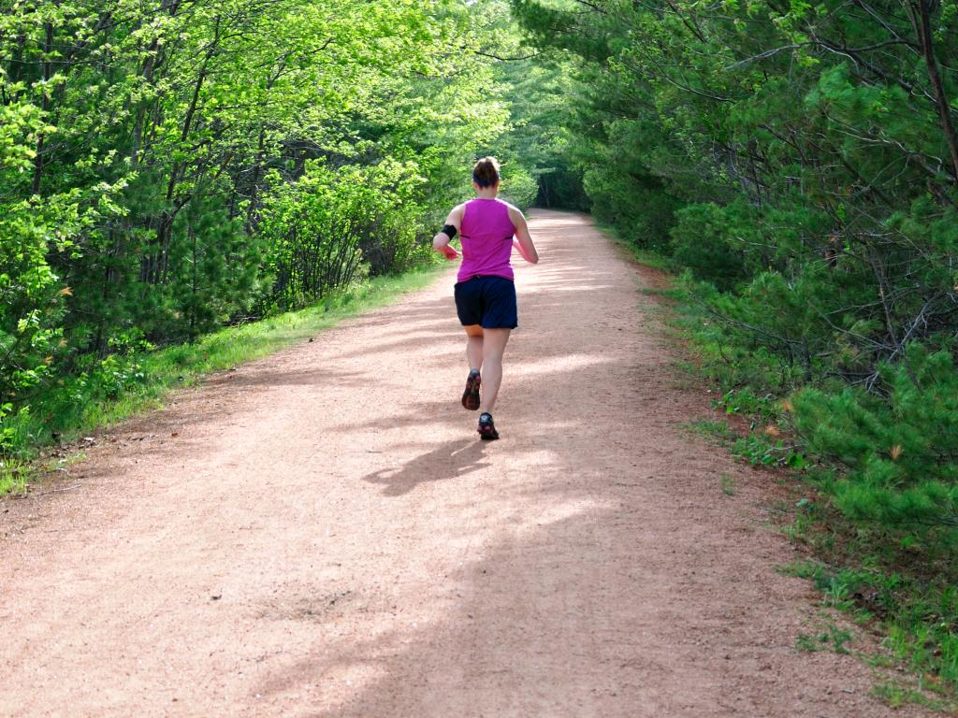
EXERCISE
30 minutes a day, or at least 150 per week
Find a type of exercise you like!
Work out with a partner or group
cc: jennifertomaloff - https://www.flickr.com/photos/45487535@N08

Slide 7
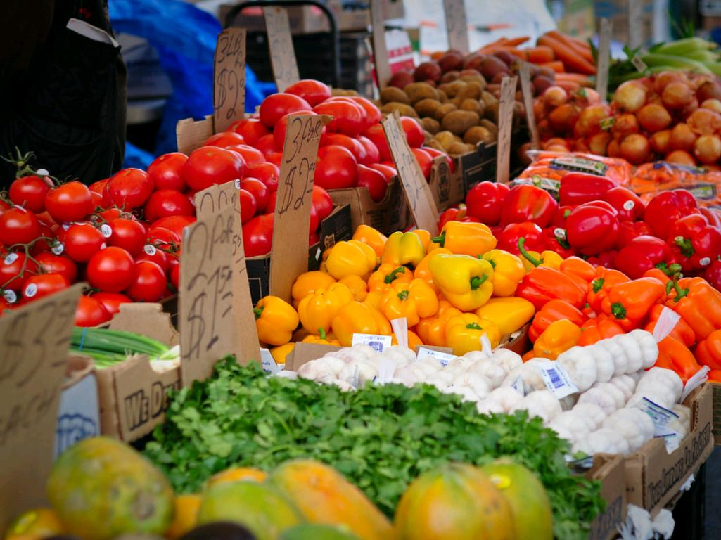
EAT HEALTHY
Eat your fruits and veggies!
Limit added sugar, processed food and animal fat
Take time to enjoy your food
Stay hydrated
cc: Werner Kunz - https://www.flickr.com/photos/35375520@N07

Slide 8

SPEND TIME OUTSIDE
Take a breather- fresh oxygen energizes the brain
It boosts your immune system
Decreases stress, increase happiness
Huffington Post, 2014
cc: natalielucier - https://www.flickr.com/photos/36121888@N08

Slide 9
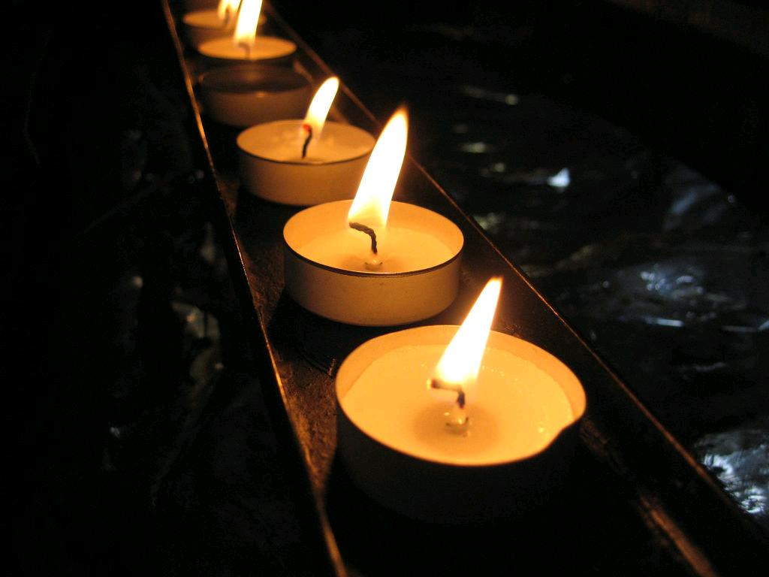
STAY IN TOUCH WITH YOUR SPIRITUALITY/RELIGION
cc: Xerones - https://www.flickr.com/photos/50835495@N00

Slide 10

SPEND TIME WITH FAMILY/FRIENDS/PETS
cc: garryknight - https://www.flickr.com/photos/8176740@N05

Slide 11
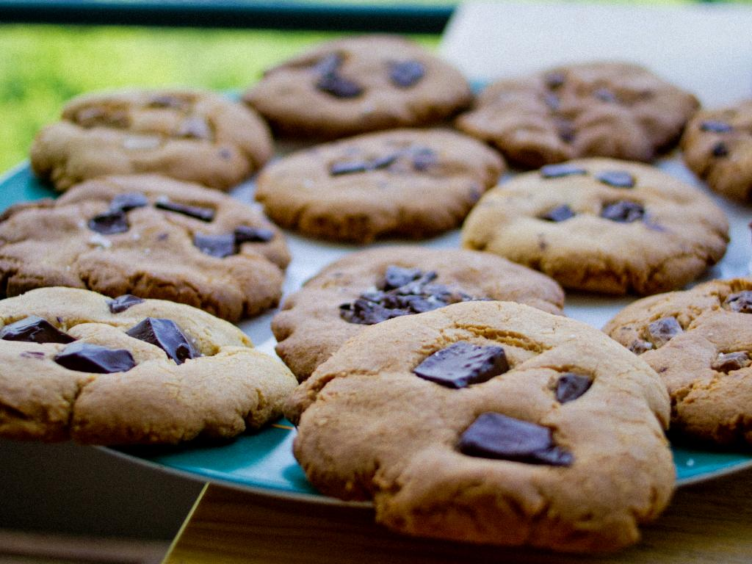
TREAT YOURSELF
cc: Le Yéti - https://www.flickr.com/photos/33693605@N03

Slide 12

TRY SOMETHING NEW!
LINK TO 10 THINGS TO DO IN BALTIMORE?
cc: Vlastula - https://www.flickr.com/photos/46026252@N00

